Slide 1
Hospital Record Management System

Slide 2
Hospital Record Management System
Hospital is an institution that works to provide medical care for patients in need.
A hospital record management system is a software designed to manage & record all the areas of a hospital such as medical, financial, administrative and the corresponding processing of services.

Slide 3
Hospital Record Management System(continued)
Main bodies
Admin
Doctor
Patient
Nurse
Pharmacist
Accountant

Slide 4
Admin’s Role
Have access to every data like:
Patient’s information
Employee’s information
Doctor’s appointment and prescription
Reports

Slide 5
Doctor’s Role
Schedule appointment with patient
Change appointment
Prescription
View appointments

Slide 6
Nurse’s Role
Report the status of the patient
Taking care for the patient

Slide 7
Laboratorists and Pharmacists Role
View prescriptions
Add if necessary
Can also view all other necessary information for effectiveness

Slide 8
Patient’s Role
View appointment
View prescription
Payment

Slide 9
Accountant’s Role
Control the financial flow like checking the patients payment

Slide 10
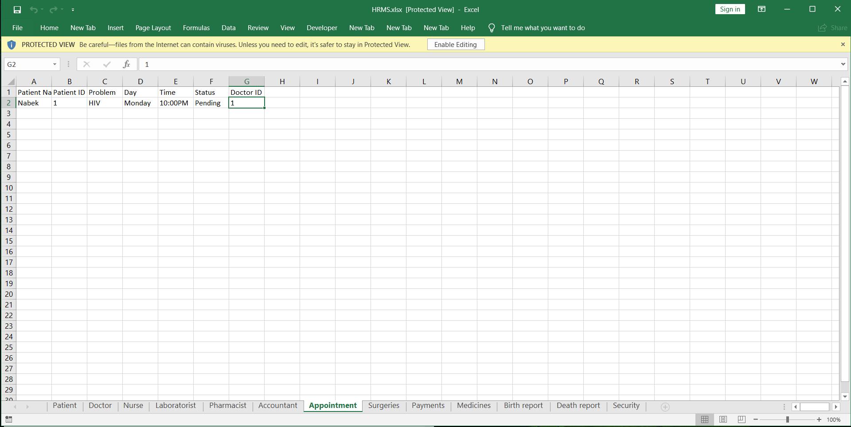
Excel and Python Implementation
We did:
Create excel sheet for each entries

Slide 11
Excel and Python Implementation(continued)
Then, we link it with python using ‘openpyxl’ module

